Slide 1
CS 4031 Compiler Construction Lecture 14
Faryal Saud
Lecturer, Department of Computer Science
FAST NUCES CFD

Slide 2
Techniques of Code Optimization
Optimization performed within a basic block.
This is simplest form of optimizations.
No need to analyze the whole procedure body
Just analyze the basic block of the procedure

Slide 3
Techniques of Local Code Optimization
The local optimization techniques include:
Constant folding
Constant propagation
Algebraic Simplification
Operator strength reduction
Dead code elimination

Slide 4
Constant Folding
As the name suggests, this technique involves folding the constants by evaluating the expressions that involves the operands having constant values at the compile time.
Example:
Circumference of circle = (22/7) x Diameter
Replace (22/7) with 3.14
during compile time and save the execution time.

Slide 5
Constant Propagation
In this technique, if some variable has been assigned some constant value, then it replaces that variable with its constant value in the further program wherever it has been used during compilation, provided that its value does not get alter in between.
Example:
pi = 3.14, radius = 10
Area of circle = pi x radius x radius
Substitutes constants value during compile time and saves the execution time.

Slide 6
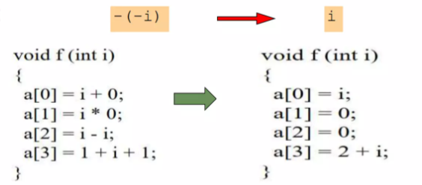
Algebraic Simplification
Use algebraic properties to simplify expressions
Some expressions can be simplified by replacing them with an equivalent expression that is more efficient

Slide 7

Strength Reduction
As the name suggests, this technique involves reducing the strength of the expressions by replacing the expensive and costly operators with the simple and cheaper ones
Improved Execution Speed
Expensive operations, such as multiplication and division, are replaced with simpler ones like addition or bitwise shifts, which execute faster.
Example:
Instead of X * 2, use X + X, which is computationally cheaper.

Slide 8
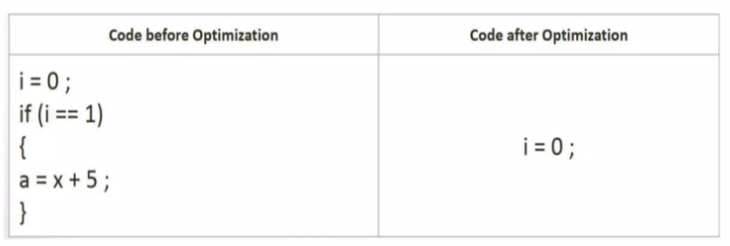
Dead code Elimination
Those code are eliminated which either never executes or are not reachable or even if they get execute, their output is never utilized.

Slide 9
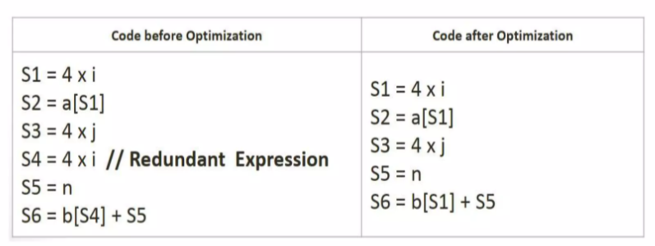
Common sub expression Elimination
Eliminates the redundant expressions and avoids their computation again and again.

Slide 10
Example:
int main() {
int a = 5;
int b = 10;
int c = a * 2;
int d = a * 2; // redundant computation
int e = b + c;
return e;
}

Slide 11
Solution
int main() {
int a = 5;
int b = 10;
int c = a * 2;
int d = c;
int e = b + c;
return e;
}

Slide 12
Global Code Optimization
Optimization across basic blocks within a procedure /function
Could be restricted to a smaller scope,
Example: a loop
Data-flow analysis is done to perform optimization across basic blocks
Each basic block is a node in the flow graph of the program.
These optimizations can be extended to an entire control - flow graph
Most of compiler implement global optimizations with well founded theory and practical gains

Slide 13
Peephole optimization
technique that operates on the one or few instructions at a time.
Performs machine dependent improvements
Peeps into a single or sequence of two to three instructions (peephole) and replaces it by most efficient alternative (shorter or faster) instructions.
Peephole is a small moving window on the target system

Slide 14

Characteristics of Peephole optimization
Redundant-instruction (loads and stores)elimination
Flow-of-control optimizations
Elimination of multiple jumps (i.e. goto statements)
Elimination of unreachable code
Algebraic simplifications
Reducing operator strength
Use of machine idioms
Provide low level code

Slide 15
Loop Optimization
optimization plays an important role in improving the performance of the source code by reducing overheads associated with executing loops.
Loop Optimization can be done by removing:
Loop invariant
Induction variables

Slide 16
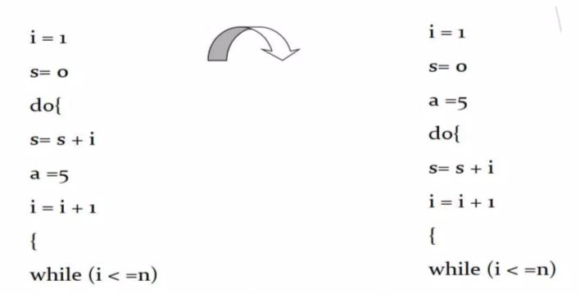
Example: Removal of Loop Data
In this case, the assignment a = 5 is redundant within the loop—it does not change during iterations. By moving it outside the loop, the computation is performed only once instead of repeatedly during each iteration.

Slide 17
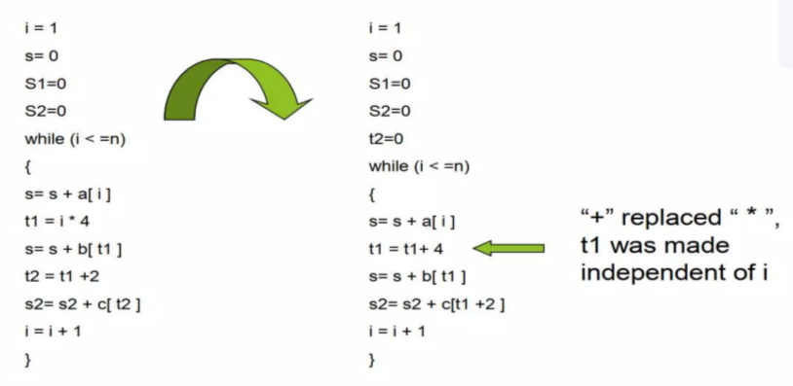
Example: Induction Variable
Instead of performing multiplication (t1 = i * 4), which is relatively expensive, the optimized code uses addition (t1 = t1 + 4), which is faster.

Slide 18
Example:
int main() {
int sum = 0;
int x = 10;
for (int i = 0; i < 1000; i++) {
sum += x * 2; // x*2 is computed in every loop iteration
}
return sum;
}

Slide 19
Solution:
int main() {
int sum = 0;
int x = 10;
int temp = x * 2; // moved out of the loop
for (int i = 0; i < 1000; i++) {
sum += temp;
}
return sum;
}

